Slide 1

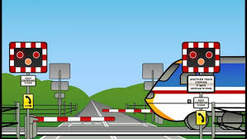
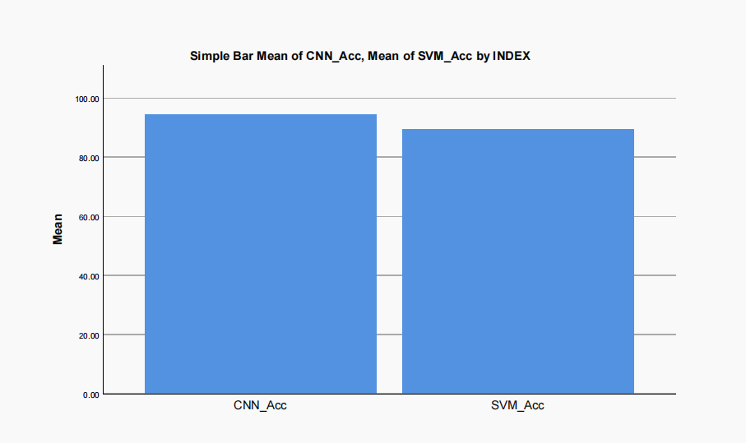
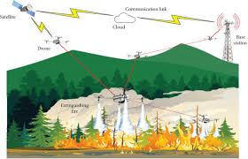
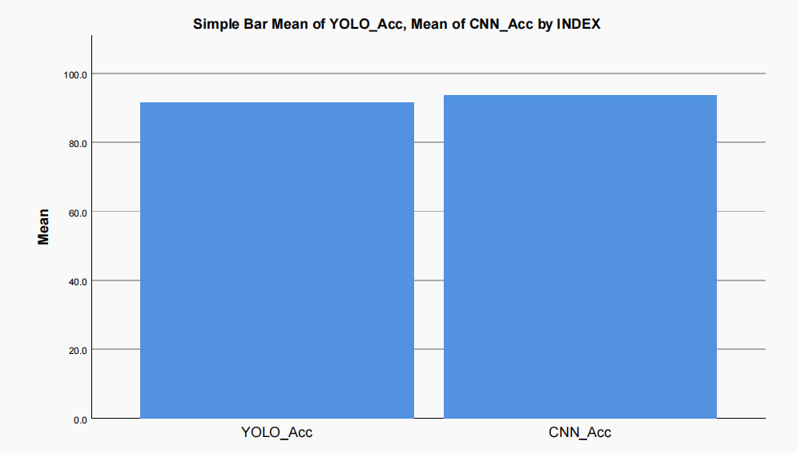
Register No: 192372005
Students Name: B. Nageswar
Guided By Dr. S.Magesh Kumar
Railway Gate Automation Using IoT With SVM And CNN
INTRODUCTION
Railway gate automation is an essential component of modern transportation systems, aiming to enhance safety and efficiency at level crossings using intelligent control and monitoring the technologies.
Machine learning models like SVMs and CNNs integrate with IoT sensors for train detection and gate automation, enabling real-time response, improved accuracy, and reduced human intervention at crossings.
Enhances safety by preventing accidents at unmanned railway level crossings through intelligent automated control systems.
Fig. 1. Automatic Railway Gate
MATERIALS AND METHODS
Sensor Data collection and Preprocessing
Model training
Model Evaluation
Model Comparison and Optimization
Deployment:
RESULTS
Table 1. Group Stastical Analysis of Support Vector Machine and Convolutional Neural Network
 | Algorithm | N | Mean | Std.deviation | Std.error mean
Accuracy | SVM | 10 | 85.40 | 94.07 | 3.10667
 | CNN | 10 | 90.42 | 99.60 | 2.21100
Fig. 2. Comparison of SVM and CNN
DISCUSSION AND CONCLUSION
The Convolutional Neural Network (CNN) achieved higher accuracy with more consistent results compared to the Support Vector Machine (SVM). This demonstrates CNN’s superior ability to learn complex patterns and generalize well, leading to more reliable with the CNN.
While SVM models are simpler and easier to train, their performance declined with real-time, noisy data, suggesting that CNN offers a more robust and adaptable solution for gate automation, especially in dynamic and unpredictable environments patterns and generalize well.
BIBLIOGRAPHY
Patil, S., Jadhav, M. and Patil, P., 2018. Intelligent railway crossing system using IoT and machine learning for real-time accident prevention and safety. In Smart Innovations in Communication and Computational Sciences (pp. 97–105) with improved reliability.
Sharma, V., Kumar, A., and Singh, R., 2021. Railway gate automation using sensor-based IoT and CNN model for efficient and secure train crossings. Journal of Intelligent & Fuzzy Systems, 41(3), pp.3561–3569 for minimizing delays and enhancing monitoring, p., 2004.
Drone-Based Forest Fire Detection Using YOLO And CNN
INTRODUCTION
Importance: Forest fire detection is critical for environmental protection and disaster management, quick response and minimizing damage to ecosystems and human communities for resource allocations.
Technology: YOLO and CNN models can accurately detect forest fires from aerial drone images efficiently.
Real-time aerial monitoring enables early and accurate forest fire detection using deep learning techniques.
Fig. 1. Drone Fire Detection
MATERIALS AND METHODS
Data collection and Preprocessing
Model training
Model Evaluation
Model Comparison and Optimization
Deployment:
RESULTS
Table 1. Group Stastical Analysis of You Only Look Once and Convolutional Neural Network
 | Algorithm | N | Mean | Std.deviation | Std.error mean
Accuracy | YOLO | 10 | 93.32 | 3.3139 | 3.21007
 | CNN | 10 | 91.32 | 3.65476 | 2.05310
Fig. 2. Comparison of YOLO and CNN
DISCUSSION AND CONCLUSION
The YOLO and Convolutional Neural Network (CNN) models achieved higher accuracy with more consistent results in detecting forest fires from drone imagery. This demonstrates their superior capability to identify fire patterns to more reliable early warnings to fire.
While traditional image processing methods are simpler and faster to implement, their performance declined significantly under varying lighting and weather conditions, as well as with noisy aerial data. This suggests that the combined YOLO and CNN unpredictable forest natures
BIBLIOGRAPHY
Li, X., Zhang, Y., and Wang, J., 2020. Drone-based forest fire detection using deep learning and thermal imaging for early warning and rapid response. In Proceedings of the International Conference on Environmental Monitoring (pp. 112–120) with enhanced accuracy.
Kumar, S., Gupta, R., and Verma, P., 2022. Real-time forest fire detection system using UAVs and YOLO-CNN model for timely alerts and effective firefighting. Remote Sensing Letters, 13(7), pp. 634–642 for improving detection speed and situational awareness.

